Slide 1
CS 589 Fall 2021 Lecture 7
word embedding
Monday 6:30-9:00
Babbio 122
All zoom links in Canvas
Most slides adapted from Stanford CS224 (Instructor: Abigail See)
photo: https://www.scubedstudios.com/information-retrieval/
Notes:
In this lecture, we will be talking about probabilistic ranking models, which is

Slide 2
Review of Lecture 6
Expectation maximization
Maximizing the likelihood estimation under the latent space assumption
Complete likelihood vs. incomplete likelihood
E step vs M step
Theorem: The incomplete log likelihood p(x|theta) is guaranteed to not decrease during EM iterations
The coin topic problem
Derive the EM algorithm when p(w|T) and p(w|H) are known, lambda is unknown, etc.
Notes:
For the simplest method for learning to rank, we can simply leverage a binary classification or a regression algorithm, where in classification, we retrieve the documents where the predicted label is 1, and in regression, we rank the documents based on their predicted score.
Next we talked about two learning to rank algorithms, i.e., MART and RankNet.

Slide 3
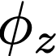
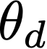
Review of PLSA
Phi T x V, V: vocabulary size ~50,000, T: #topics, T=20
theta D x T, D: #documents: ~10,000, T: #topics, T=20
city 0.2 new 0.1 orleans 0.05 ...
donate 0.1 relief 0.05 help 0.02 ...
government 0.3 response 0.2 ...
the 0.04 a 0.03 ...
Orleans 0.05
0.5
0.3
0.1
0.1
[ Criticism of government response to the hurricane ..] to the [ flooding of New _______
[ Criticism of government response to the hurricane ..] to the [ flooding of New Orleans
Step 1: sample a topic: topic 2
Step 2: sample a word from topic 2
Probabilistic Latent Semantic Analysis. Thomas Hoffman. 2001.

Slide 4
LSI vs PLSA vs LDA
LSI (1998)
PLSA (2002)
LDA (2003)
Indexing by latent semantic analysis. Deerwester et al. 1998
Probabilistic latent semantic analysis. Thomas Hoffman. 2001
Latent Dirichlet allocation. Blei et al. 2003
Notes:
we use Google playstore data as the data source, so we collect these data, we clean it, we split the sentence, and we build a filtering algorithm to select the high quality sentence

Slide 5
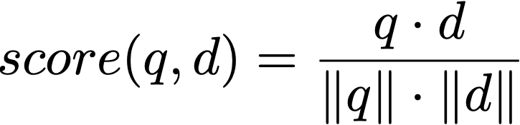
Vocabulary gap problem with the vector space model
Vector space model:
Challenges matching synonyms
e.g., auto vs. car
Challenges matching polysemy
e.g., apple (fruit vs. company)
doc1
doc2
car
0
1
0
0
auto
1
x
0
0
0
0
0
0
0
Notes:
we use Google playstore data as the data source, so we collect these data, we clean it, we split the sentence, and we build a filtering algorithm to select the high quality sentence

Slide 6
Latent semantic indexing
word indexing
latent concept indexing
car
0
1
0
0
0.5
0.2
"car insurance"
latent semantic indexing
auto
1
x
0
0.3
x
0.3
"auto repair"
0
0
0.2
0.1
0
0
0
0
d1="buy insurance"
d2="repair car"
d1="buy insurance"
d2="repair car"
Indexing by latent semantic analysis. Deerwester et al. 1998
Notes:
we use Google playstore data as the data source, so we collect these data, we clean it, we split the sentence, and we build a filtering algorithm to select the high quality sentence

Slide 7
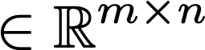
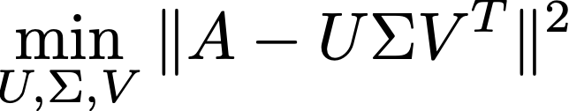
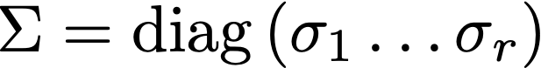
Singular value decomposition (matrix factorization)
For a matrix A , approximate A with a singular value decomposition (SVD):
U: V x r
V: r x D
Sigma: r x r
Notes:
we use Google playstore data as the data source, so we collect these data, we clean it, we split the sentence, and we build a filtering algorithm to select the high quality sentence

Slide 8
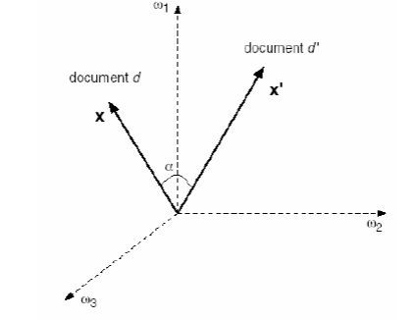
Low dimensional vector representation of words
Axes are concepts, also called principal components (PCA)
“money” = [0,0,0,1,0,0]
“auto repair”
“car insurance”
d1
“auto” = [0,0,1,0,0,0]
d2
“car” = [1,0,0,0,0,0]
Notes:
we use Google playstore data as the data source, so we collect these data, we clean it, we split the sentence, and we build a filtering algorithm to select the high quality sentence

Slide 9
Latent semantic indexing
Uses statistically derived conceptual indices instead of individual word indexing for retrieval
Assumes that there is some underlying or latent structure in word usage that is obscured by variability in word choice
Key idea: instead of representing documents and queries as vectors in a low dimensional space of terms
Notes:
we use Google playstore data as the data source, so we collect these data, we clean it, we split the sentence, and we build a filtering algorithm to select the high quality sentence

Slide 10
What LSI can do
LSI effectively does
Dimensionality reduction
Noise reduction
Exploitation of redundant data (linearity)
Correlation analysis and query expansion (with related words)
Some of the individual effects can be achieved with simpler techniques (e.g. thesaurus construction). LSI does them together
LSI handles synonymy well, not so much polysemy (vs word embedding)
Challenge: SVD is complex to compute (O(n3 )) – Needs to be updated as new documents are found/updated
Notes:
we use Google playstore data as the data source, so we collect these data, we clean it, we split the sentence, and we build a filtering algorithm to select the high quality sentence

Slide 11
From LSI to word embedding
+ probability
+ prior
EM algorithm
var. inf.
LSI (1998)
PLSA (2002)
LDA (2003)
word embedding (2013)
Notes:
we use Google playstore data as the data source, so we collect these data, we clean it, we split the sentence, and we build a filtering algorithm to select the high quality sentence

Slide 12
Today’s lecture
Language models
Word2vec [Mikolov et al. 2013]
Recurrent neural network
Vanilla recurrent neural network
Long short-term memory (LSTM)
Gated recurrent unit (GRU)
Notes:
we use Google playstore data as the data source, so we collect these data, we clean it, we split the sentence, and we build a filtering algorithm to select the high quality sentence

Slide 13
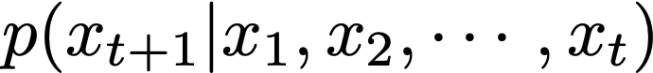
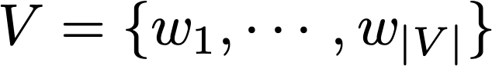
Language models
Language modeling is the task of predicting what word comes next
Given a sequence of words x1, x2, …, xt, compute the probability distribution for the next word xt+1
where xt+1 can be any word in the vocabulary
0.2
lamb
goat
0.3
mary has a little
bit
0.05
book
0.01
Notes:
we use Google playstore data as the data source, so we collect these data, we clean it, we split the sentence, and we build a filtering algorithm to select the high quality sentence

Slide 14
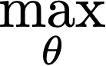
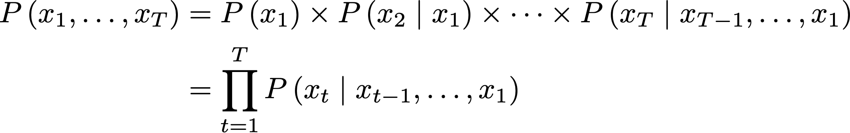
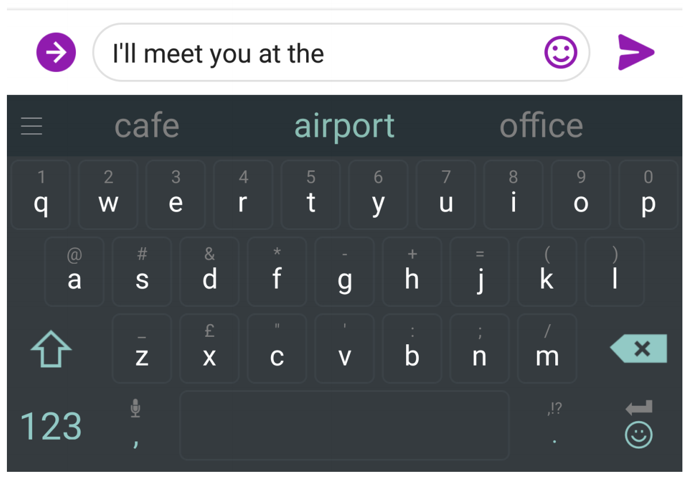
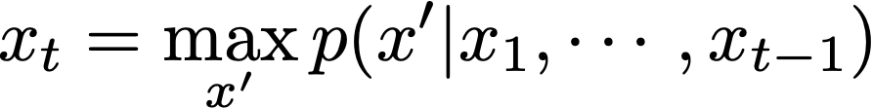
Language models
Training (chain rule):
Prediction:
How to model the probability in language model?
Notes:
we use Google playstore data as the data source, so we collect these data, we clean it, we split the sentence, and we build a filtering algorithm to select the high quality sentence

Slide 15
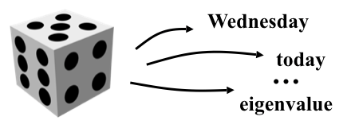
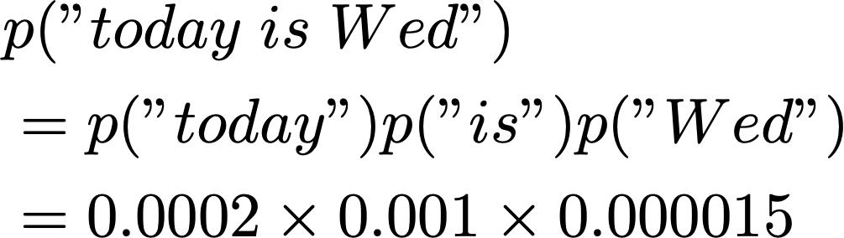
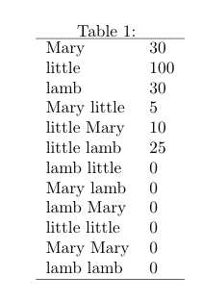
Statistical language models
Collect statistics about how frequent different n-grams are, and use these to predict next word
Unigram language model using MLE:
Bigram language model using MLE:
Notes:
we use Google playstore data as the data source, so we collect these data, we clean it, we split the sentence, and we build a filtering algorithm to select the high quality sentence

Slide 16
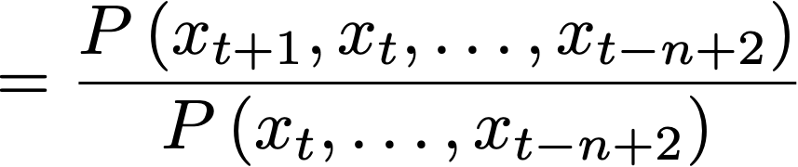
Language models
Markov assumption: xt+1 depends only on the preceding n-1 words:
How do we get the n-gram statistics? By counting the n-grams in a large corpus of text
Sparsity problem with n-gram LM: what if “mary has a little” never occurred?
Partial solution: just condition on “a little” instead
Trade off between granularity and sparsity
Notes:
we use Google playstore data as the data source, so we collect these data, we clean it, we split the sentence, and we build a filtering algorithm to select the high quality sentence

Slide 17
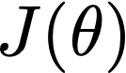
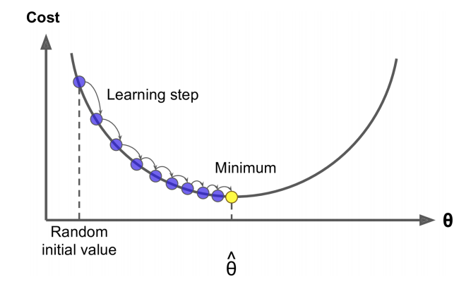
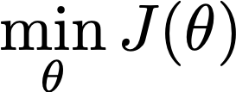
Gradient descent (optimization method)
We have a cost function we want to minimize
There are a list of optimization algorithm (for both convex and non-convex objectives), the most popular one is gradient descent (first-order optimization)
At each iteration, GD calculate gradient of , then take small step in direction of negative gradient
Training loss: CE, margin loss
Notes:
we use Google playstore data as the data source, so we collect these data, we clean it, we split the sentence, and we build a filtering algorithm to select the high quality sentence

Slide 18
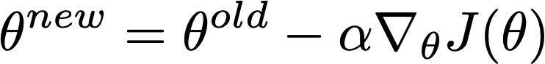
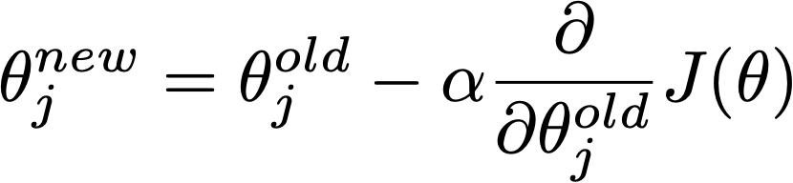
Gradient descent algorithm
Repeat
Notes:
we use Google playstore data as the data source, so we collect these data, we clean it, we split the sentence, and we build a filtering algorithm to select the high quality sentence

Slide 19
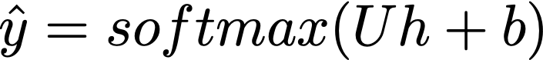
Neural network for NLP
Output: a class label, a score, a word, …
output distribution
backpropogation (gradient descent)
hidden layer
embedding layer:
maps a 1-hot vector to low dim representation
randomly initialized
can be trained
0.5
0.2
…
…
0.3
…
0.3
0.2
0.1
…
…
car
…
auto
one hot vector
Notes:
we use Google playstore data as the data source, so we collect these data, we clean it, we split the sentence, and we build a filtering algorithm to select the high quality sentence

Slide 20
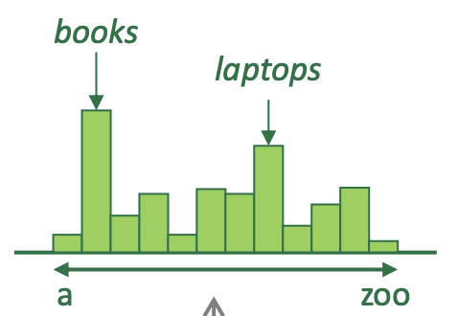


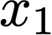
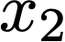
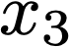
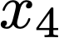
Neural language models
Bengio et al. (2000/2003): a neural probabilisitic LM using fixed window:
Improvements over n-gram LM:
No sparsity problem
Don’t need to store all observed n-grams
lamb
goat
Remaining problems:
Fixed window size too small, enlarging window size enlarges W but window can never be large enough
Words at different positions use different weights, no symmetry
4 x N (size of embedding)
mary
has
a
little
Notes:
we use Google playstore data as the data source, so we collect these data, we clean it, we split the sentence, and we build a filtering algorithm to select the high quality sentence

Slide 21
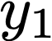
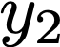
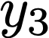
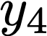

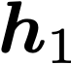
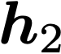
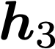
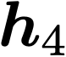
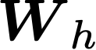
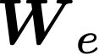
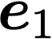
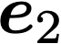
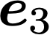
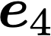
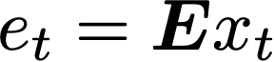
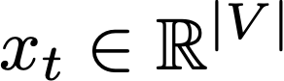
Recurrent neural network (RNN)
Core idea: apply the same weights W repeatedly
output distribution
optional
hidden state
word embeddings
N x V
word/one-hot vectors
mary
has
a
little
Notes:
So this motivates us to introduce a new family of neural architecture called recurrent neural network.
This is a simplified diagram that shows you the most important features of an RNN.
We gave a sequence "mary has a little", but this sequence can be of any length. Different from the previous model, the number of hidden states here are the same as the input length.
Each hidden state is the output of the previous hidden state and the input at the next step, it looks like h_t is mutating over time, so we call t the time step, and this recurrent network architecture is like a time series.
One question is where we get this initial hidden state h0 from? It can either be a parameter that you learn from the network, or it can be zero.
The important thing here is that the same matrix W_h is applied at every time step. This allows us to process any length of input without having to increase the number of parameters. Because we just apply the same transformation in every step.
These y hats are optional, because the training of rnn doesn't have to rely on them. There are essentially two ways to train a recurrent neural network:

Slide 22
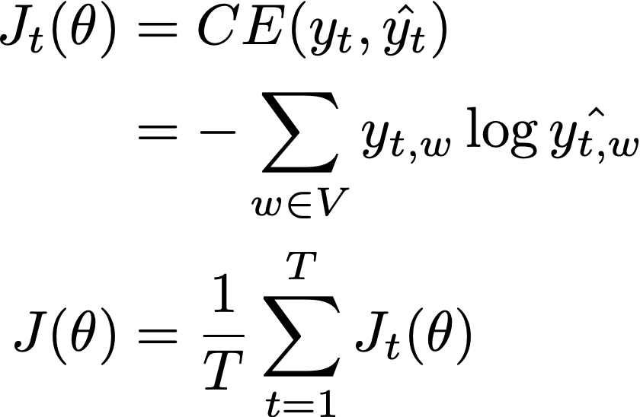
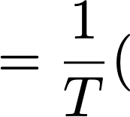
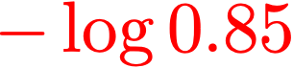
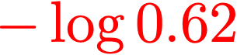
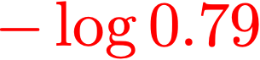
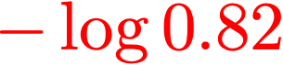

Training RNN method 1: Language modeling
Minimizes the cross entropy loss:
a
[0.79,
[0.09,
[0.01,
[0.09,
[0.79,
...
...
...
...
0.62,
0.62,
little
0.82,
0.01,
...
0.01,
0.82,
...
mary
0.85]
0.10]
0.10]
0.85]
0.10]
mary
has
a
little
Notes:
So The first method for training an RNN is language modeling.
Language modeling means we are training the model such that it tries to predict the next word. For example, we can use the cross entropy loss, where y_{t,w} are the ground truth and log_{hat{y_{t,w}}} are the predictions
So each y_{t,w} is the ground truth, which is a one hot vector, and these are the values of log_{hat{y_{t,w}}} which are the predictions for the probability of each word. So the cross entropy loss would be equal to this summation, for mary...
And the goal of the training is to train the weights W here so that this sum is minimized

Slide 23






Training RNN method 2: Text classification
output distribution
pos
[0.2,
neutral
0.5,
Cross entropy loss (min):
neg
0.3]
Accuracy (max):
mary
has
a
little
Notes:
A SECOND method for training an RNN is text classification. For example, we can train the network for the sentiment analysis task. In this case, we are not using y1, y2, y3. Instead, for each sentence, we only use one of the output softmax, which is the last one y_4. We also adjust the size of this U such that the output yhat is a vector of size 3 instead of V. For each, sentence we compute *one* cross entropy loss.

Slide 24

Training RNN with SGD
Gradient descent (computing loss and gradients across entire corpus) is too expensive
Improving the training efficiency using SGD:
Smaller batch size: takes less memory
Large batch size: converges faster
Typical batch size: 1, 2, 4, 8, 16, 32, ...
Notes:
Previously we learned that you can use gradient descent to train an RNN. However, if you have a very large corpus, computing J(theta) across the entire corpus and taking the derivative is too expensive. So in practice, we can use stochastic gradient descent. Different from GD, SGD only takes a small batch of examples for the gradient each time, for example, 16 or 32 examples, which are randomly sampled from the entire dataset. this allows the gradient descent to move faster: we can proceed after each batch, instead of waiting for the entire corpus.

Slide 25
Advantages and disadvantages of RNN
Advantages (over the neural probabilistic language model):
Can process input of any length
Theoretically, at step t, we can look back for a long distance
Model size does not increase for longer sentences
Words at different positions share the same weight, so more efficient at training these weights
Disadvantages:
Backprop is slow if the sequence is long
In practice, it is still difficult to access information many steps back
Notes:
What are some advantages and disadvantages of the RNN model?

Slide 26



Chain rule
Chain rule of partial derivative:
Multivariate chain rule:
Notes:
https://d2l.ai/chapter_recurrent-neural-networks/bptt.html

Slide 27


Back propagation through time (BPTT)
depends on Wh, needs multivariate chain rule
mary
has
a
little
Notes:
we use Google playstore data as the data source, so we collect these data, we clean it, we split the sentence, and we build a filtering algorithm to select the high quality sentence

Slide 28

Vanishing gradient problem in RNN
h1's effect does not matter
: sigmoid function
partial derivative ~ zero at both ends
Image source: http://www.wildml.com/2015/10/recurrent-neural-networks-tutorial-part-3-backpropagation-through-time-and-vanishing-gradients/
Notes:
http://www.wildml.com/2015/10/recurrent-neural-networks-tutorial-part-3-backpropagation-through-time-and-vanishing-gradients/

Slide 29



Vanishing gradient problem in RNN
Recall:
What if the sigma function is the identity function, i.e., ?
Consider the gradient of loss in step i with respect to step j’s hidden vector. If Wh is small (large), the gradient gets exponentially small (large), causing the vanishing (exploding) gradient problem:
Notes:
we use Google playstore data as the data source, so we collect these data, we clean it, we split the sentence, and we build a filtering algorithm to select the high quality sentence

Slide 30
Example of vanishing gradient
When she tried to print her tickets, she found that the printer was out of toner. She went to the stationery store to buy more toner. It was very overpriced. After installing the toner into the printer, she finally printed her ________
RNN needs to model the dependency between the first “ticket” and the word to fill in the blank
If the gradient is too small, RNN cannot learn this dependency, makes it difficult to tell between
There’s no dependency between step t and t+n
We have the wrong parameter to capture the dependency
Notes:
we use Google playstore data as the data source, so we collect these data, we clean it, we split the sentence, and we build a filtering algorithm to select the high quality sentence

Slide 31
Problem caused by exploding gradient
Exploding gradient: the similar problem as the vanishing gradient problem
Problem 1: we take a large step and reach a bad parameter position
Problem 2: resulting in Inf or NaN in your network (anyone has experienced this problem?)
Solution 1: gradient clipping. Scale down the gradient if larger than a threshold
Notes:
we use Google playstore data as the data source, so we collect these data, we clean it, we split the sentence, and we build a filtering algorithm to select the high quality sentence

Slide 32
Why word embedding
In RNN, we randomly initialize the weight, use the back propagation to update this weight
The random initialization may not give us a good starting point
We can choose a better starting point with embedding vectors pertained in a large corpus to help the initialization [Mikolov et al. 13]
mary
has
a
little
Notes:
There are three ways for word embedding: fix, or fine tune, or random initialize

Slide 33

What makes a good starting point?
Distributional semantics: A word’s meaning is given by the words that frequently appear close-by
“You shall know a word by the company it keeps” (J. R. Firth 1957)
these contexts will represent “banking”
Notes:
we use Google playstore data as the data source, so we collect these data, we clean it, we split the sentence, and we build a filtering algorithm to select the high quality sentence

Slide 34



Word2vec Overview [Mikolov et al. 13]
Skipgram: maximizing the probability of the context words given w_t
probability of predicting w_t+j in contrast to predicting any other words
Notes:
we use Google playstore data as the data source, so we collect these data, we clean it, we split the sentence, and we build a filtering algorithm to select the high quality sentence

Slide 35
Word2vec Overview [Mikolov et al. 13]
CBOW: maximizing the probability of w_t given context words
Notes:
we use Google playstore data as the data source, so we collect these data, we clean it, we split the sentence, and we build a filtering algorithm to select the high quality sentence

Slide 36

Word embedding results
Maximizing the probability of the context words given w_t (Skipgram)
words closest to “sweden”
Notes:
we use Google playstore data as the data source, so we collect these data, we clean it, we split the sentence, and we build a filtering algorithm to select the high quality sentence

Slide 37
Word embedding results
Maximizing the probability of the context words given w_t (Skipgram)
Notes:
we use Google playstore data as the data source, so we collect these data, we clean it, we split the sentence, and we build a filtering algorithm to select the high quality sentence

Slide 38

Skipgram with negative sampling
It is computationally expensive to use all words for normalization
In standard word2vec, implement negative sampling to improve the performance
Main idea: train binary logistic regressions for a true pair (center word and word in its context window) versus several noise pairs (the center word paired with a random word)
expensive to compute
maximize prob that context word appears
minimize prob that random words appear
Notes:
we use Google playstore data as the data source, so we collect these data, we clean it, we split the sentence, and we build a filtering algorithm to select the high quality sentence

Slide 39

Negative sampling
How to select negative samples?
The probability of selecting a word as a negative sample is related to its frequency, with more frequent words being more likely to be selected as negative samples
Instead of using the raw frequency, in the original word2vec paper, each word is given a weight that's equal to it's frequency (word count) raised to the 3/4 power
Notes:
we use Google playstore data as the data source, so we collect these data, we clean it, we split the sentence, and we build a filtering algorithm to select the high quality sentence

Slide 40



Encoding meaning in vector differences
Ratio of co-occurrence probability can encode meaning components
Capturing the ratio using a bilinear model:
Notes:
we use Google playstore data as the data source, so we collect these data, we clean it, we split the sentence, and we build a filtering algorithm to select the high quality sentence

Slide 41
Summary of word embedding
Word embedding is designed for initializing the embedding layer of a neural network
Skipgram and CBOW train word embedding vectors by predicting the probability of word generation from context words
Training of word embedding vectors can be improved using negative sampling, subsampling of frequent words, and detecting phrases
Notes:
we use Google playstore data as the data source, so we collect these data, we clean it, we split the sentence, and we build a filtering algorithm to select the high quality sentence

Slide 42

Long short term memory [Hochreiter & Schmidhuber 97]
Solution to the vanishing gradient problem
At time t, there is a hidden state h_t and a cell state c_t
Both vectors are of the same length
The cell state stores long-term information
Four gates: forget, input modulation, input, output
The forget gate helps solve vanishing gradient
Notes:
we use Google playstore data as the data source, so we collect these data, we clean it, we split the sentence, and we build a filtering algorithm to select the high quality sentence

Slide 43


Long short term memory [Hochreiter & Schmidhuber 97]
Forget gate:
https://medium.datadriveninvestor.com/how-do-lstm-networks-solve-the-problem-of-vanishing-gradients-a6784971a577
Notes:
we use Google playstore data as the data source, so we collect these data, we clean it, we split the sentence, and we build a filtering algorithm to select the high quality sentence

Slide 44

Long short term memory [Hochreiter & Schmidhuber 97]
Input and input modulation gate:
https://medium.datadriveninvestor.com/how-do-lstm-networks-solve-the-problem-of-vanishing-gradients-a6784971a577
Notes:
we use Google playstore data as the data source, so we collect these data, we clean it, we split the sentence, and we build a filtering algorithm to select the high quality sentence

Slide 45


Long short term memory [Hochreiter & Schmidhuber 97]
Output gate (controls the output hidden state):
https://medium.datadriveninvestor.com/how-do-lstm-networks-solve-the-problem-of-vanishing-gradients-a6784971a577
Notes:
we use Google playstore data as the data source, so we collect these data, we clean it, we split the sentence, and we build a filtering algorithm to select the high quality sentence

Slide 46

BPTT for LSTM
From BPTT for RNN, we saw that the major reason for vanishing gradient to happen is the product of 's.
This problem, however, does not occur for LSTM
https://medium.datadriveninvestor.com/how-do-lstm-networks-solve-the-problem-of-vanishing-gradients-a6784971a577
Notes:
we use Google playstore data as the data source, so we collect these data, we clean it, we split the sentence, and we build a filtering algorithm to select the high quality sentence

Slide 47

BPTT for LSTM
Theorem 1: The gradient of the objective function w.r.t. parameter is the sum of derivative of w.r.t. along all possible paths.
As a result, the gradient vanishes when the gradient flows through EVERY PATH from to vanish.
Let's look at one specific path and prove the gradient does not vanish there
https://prvnk10.medium.com/how-lstms-solve-the-problem-of-vanishing-gradients-ea88f08c78ca
Notes:
we use Google playstore data as the data source, so we collect these data, we clean it, we split the sentence, and we build a filtering algorithm to select the high quality sentence

Slide 48


BPTT for LSTM
avoid gradient vanishing problem by learning f_t
https://prvnk10.medium.com/how-lstms-solve-the-problem-of-vanishing-gradients-ea88f08c78ca
Notes:
we use Google playstore data as the data source, so we collect these data, we clean it, we split the sentence, and we build a filtering algorithm to select the high quality sentence

Slide 49
Discussions
Researchers have proposed many gated RNN variants, but LSTM and GRU are the most widely-used
With LSTM/GRU, gradient vanishing/explosion problem is alleviated but still exists
Vanishing/exploding gradient is not just an RNN problem
Due to chain rule, gradient can be vanishingly small as it back propagate
Notes:
we use Google playstore data as the data source, so we collect these data, we clean it, we split the sentence, and we build a filtering algorithm to select the high quality sentence

Slide 50
Final Project
Students will form into groups of 2
Propose a project by Nov 15
Discuss with me if you are not sure
Notes:
we use Google playstore data as the data source, so we collect these data, we clean it, we split the sentence, and we build a filtering algorithm to select the high quality sentence

Slide 51
Hyperparameter optimization
Deep neural network is sensitive to hyperparameters
Tuning hyperparameter is a black magic
Training requires significant time and efforts!
P100 ~$500 per month
V100 ~$1,000- $1,500 per month
Notes:
we use Google playstore data as the data source, so we collect these data, we clean it, we split the sentence, and we build a filtering algorithm to select the high quality sentence

Slide 52

Automated machine learning
Current deep learning practice
experts choose hyper parameters & settings
“end-to-end” training
AutoML: true end-to-end training
true end-to-end training
Notes:
we use Google playstore data as the data source, so we collect these data, we clean it, we split the sentence, and we build a filtering algorithm to select the high quality sentence

Slide 53


Auto-sklearn [Feurer et al. 2018]
Tuning happens behind the scene
sklearn:
NB
auto-sklearn
Notes:
we use Google playstore data as the data source, so we collect these data, we clean it, we split the sentence, and we build a filtering algorithm to select the high quality sentence

Slide 54
Hyperparameter tuning
Deep neural network is sensitive to hyper parameters
Which config to choose?
Config 1:
lr = 2e-5
batch size = 32
epoch = 3.0
max_seq_length = 128
Config 2:
lr = 5e-5
batch size = 128
epoch = 10.0
max_seq_length = 128
BERT: epoch = 3.0, RoBERTa: epoch = 10.0
Notes:
we use Google playstore data as the data source, so we collect these data, we clean it, we split the sentence, and we build a filtering algorithm to select the high quality sentence

Slide 55



Hyperparameter optimization
Definition of hyperparameter tuning:
: hyperparameter
: search space for hyperparameter
D_{train}: training dataset
D_{valid}: validation dataset
L: loss function (objective)
Notes:
we use Google playstore data as the data source, so we collect these data, we clean it, we split the sentence, and we build a filtering algorithm to select the high quality sentence

Slide 56

Hyperparameter optimization [Bergstra et al. 2012]
Grid search vs. random search
Grid search: explored 3 important hyperparameters in 9 trials
Random search: explored 9 hyperparameters in 9 trials
Notes:
we use Google playstore data as the data source, so we collect these data, we clean it, we split the sentence, and we build a filtering algorithm to select the high quality sentence

Slide 57


Bayesian optimization [Bergstra et al. 2012]
Approach: fix a probabilistic model to the function evaluation
Use that model for exploration vs. exploitation
During the development of AlphaGO, many hyper parameters were tuned with BO many times, e.g., before the match with Sedol Lee, HPO improved the win-rate from 50% -> 65%
acquisition function
Notes:
we use Google playstore data as the data source, so we collect these data, we clean it, we split the sentence, and we build a filtering algorithm to select the high quality sentence

Slide 58

Early stopping and pruning
If a trial shows bad performance, no need to keep running it
Successive halving [Jamieson et al. 2015]
A fixed amount of resources
Allocate the resources by first aggressively exploring, then exploiting
Notes:
we use Google playstore data as the data source, so we collect these data, we clean it, we split the sentence, and we build a filtering algorithm to select the high quality sentence

Slide 59

Asynchronous Successive Halving [Li et al. 2020]
Synchronous SHA are not efficient because the higher rungs are waiting for the lower rungs to finish
Instead of waiting, we can promote lower rungs to higher rungs
Time cost = 13/9 time ( R) vs. 3 time ( R)

Slide 60

Population-based training [Jaderberg et al. 2017]
Evolutionary algorithm for hyperparameter optimization

Slide 61
Summary
Neural language models can help with the sparsity problem of n-gram language model
RNN is better than NNLM because it can capture sequence of any lengths
Word embedding can be used for improving the initialization of RNN
RNN suffer from the vanishing gradient problem, the problem is alleviated using LSTM/GRU
Notes:
we use Google playstore data as the data source, so we collect these data, we clean it, we split the sentence, and we build a filtering algorithm to select the high quality sentence

